Slide 1
TIC-TAC-TOE Game
Presented By:- Puneet Goyal
CSE-3B
13BCS1193

Slide 2
INTRODUCTION
Tic-Tac-Toe is a simple way to give students alternative ways of exploring and expressing key ideas and using key skills. Typically, the Tic-Tac-Toe board has 9 cells in it, like that of the game. This can, of course, be adjusted.
Board games, which could be as simple as Tic-Tac-Toe, are where human wisdom has shined since a long time ago and are what human intelligence is trying to implement for machine intelligence for decades.

Slide 3
RULES FOR TIC-TAC-TOE
1. The game is played on a grid that's 3 squares by 3 squares.
2. You are X, your friend (or the computer in this case) is O. Players take turns putting their marks in empty squares.
3. The first player to get 3 of her marks in a row (up, down, across, or diagonally) is the winner.
4. When all 9 squares are full, the game is over. If no player has 3 marks in a row, the game ends in a tie.

Slide 4
HOW CAN I WIN TIC-TAC-TOE?
To beat the computer (or at least tie), you need to make use of a little bit of strategy.
Part of your strategy is trying to figure out how to get three X/O in a row
After you put an X in a square, you start looking ahead. Where's the best place for your next X?
You also have to watch where the computer puts its O. That could change what you do next
If you always pay attention and look ahead, you'll never lose a game of Tic-Tac-Toe. You may not win, but at least you'll tie

Slide 5
Introduction to C Language
C is a general-purpose high level language that was originally developed by Dennis Ritchie for the Unix operating system. It was first implemented on the Digital Equipment Corporation PDP-11 computer in 1972.
Easy to learn
Structured language
It can handle low-level activities.
It can be compiled on a variety of computers.
It produces efficient programs.

Slide 6
Tools/Technologies to be used for implementation of Project
HARDWARE PROFILE | HARDWARE REQUIRED
Central Processing Unit | Pentium II or higher (233 MHz or higher)
Hard Disk Drive | 600 MB on system drive, 10 GB on disk drive
RAM | With minimum capacity
Display | VGA display

Slide 7
Skills required in Software | Software Designation
Front End | C
Back End | MS-Acess
Operating System | Windows7, Window8.

Slide 8
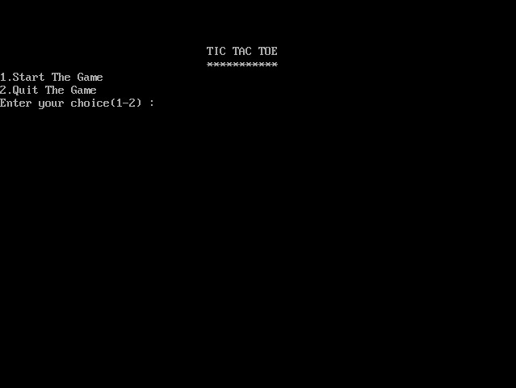
CODING OUTPUT

Slide 9
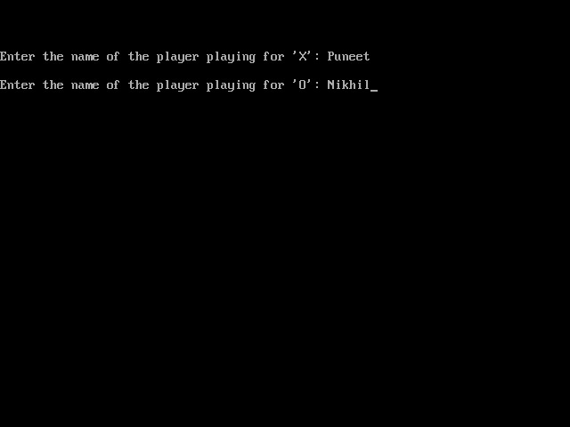

Slide 10
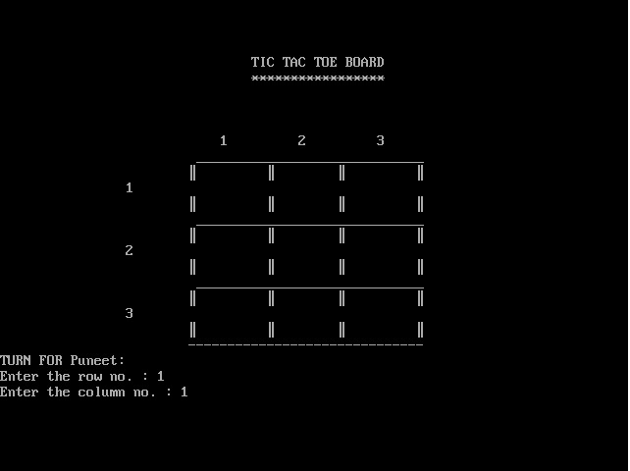

Slide 11
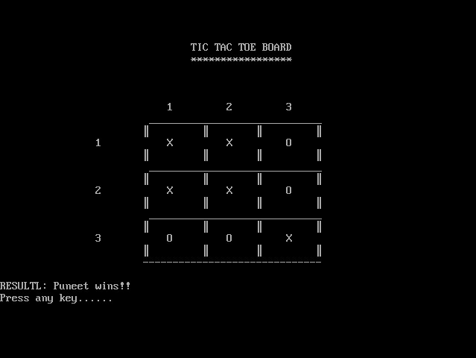
WIN CONDITION

Slide 12
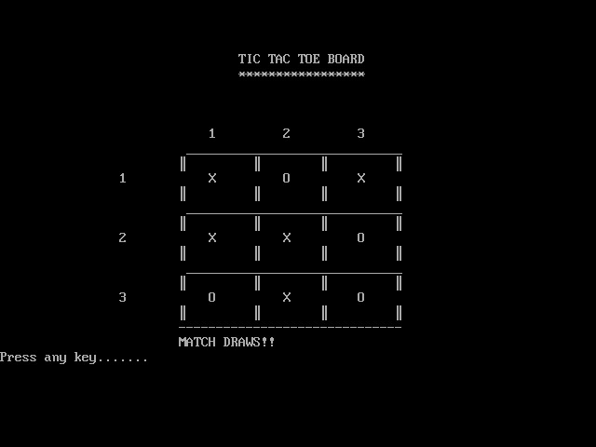
DRAW CONDITION

Slide 13
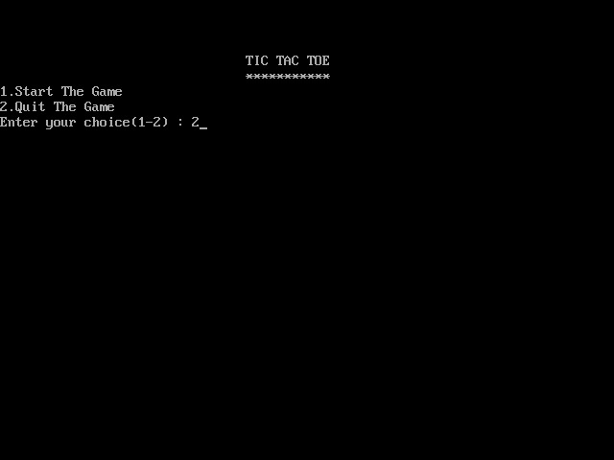
QUIT CONDITION

Slide 14
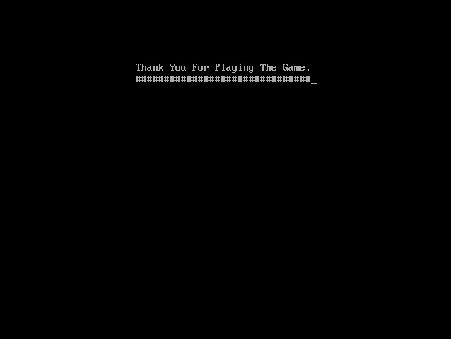

Slide 15
THE END
ANY QUESTION
?

